Slide 1

Allergy Diagnosis Testing
Wisnu Barlianto
Division of Allergy-Immunology
Department of Pediatric
Faculty of Medicine University of Brawijaya
Saiful Anwar Hospital Malang

Slide 2
Outline
What is allergy?
Skin test
Provocation test
Cellular allergy testing
Allergen-specific IgE

Slide 3
Background
Allergic diseases are common in childhood
Significant morbidity and impaired quality-of-life of the children and their families
Adequate allergy testing is the prerequisite for optimal care

Slide 4
The term “Allergy” was born on July 24, 1906
“specifically altered reactivity of the organism”

Slide 5
Allergy is a hypersensitivity reaction initiated by immunological mechanism
Allergy diseases can involve the respiratory system (asthma, rhinitis), the gastrointestinal tract (food allergy), skin (eczema, contact dermatitis)
Atopy is a personal and/or familial tendency, usually in childhood or adolescence, to become sensitized and produce IgE antibodies in response to ordinary exposure to allergens, usually proteins

Slide 6
Types of Hypersensitivity Reactions (Gell-Coombs classification)
Immediate hypersensitivity/ Allergic reaction (type I hypersensitivity)
Antibody mediated hypersensitivity (type II hypersensitivity)
Immune complex diseases (type III hypersensitivity)
T cell–mediated diseases/ Delayed type of hypersensitivity (type IV hypersensitivity)

Slide 7
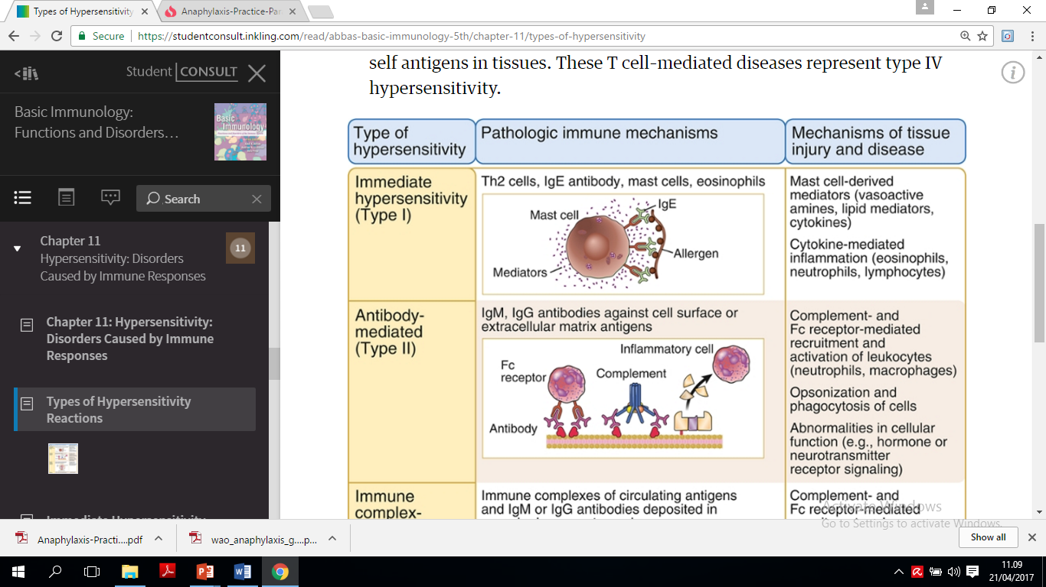
Types of Hypersensitivity Reactions

Slide 8
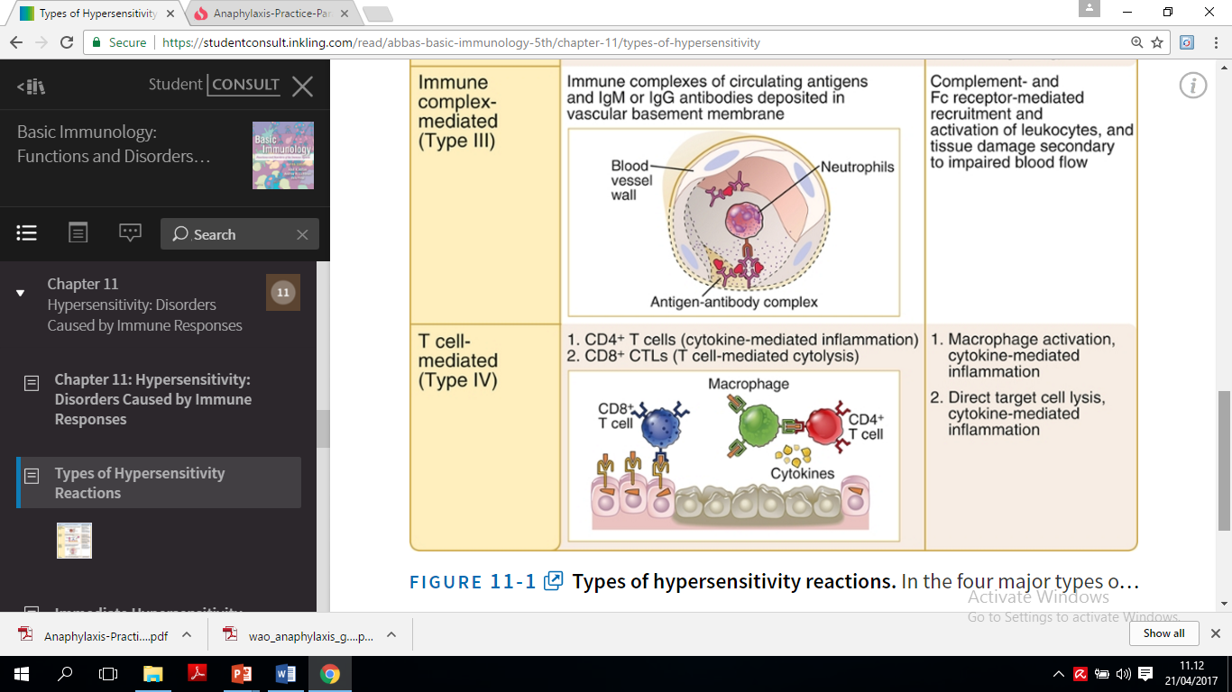

Slide 9
Immediate Hypersensitivity
Immediate hypersensitivity is an IgE antibody– and mast cell–mediated reaction to certain antigens that causes rapid vascular leakage and mucosal secretions, often followed by inflammation
Disorders in which IgE-mediated immediate hypersensitivity is prominent are also called allergy, or atopy, and individuals with a propensity to develop these reactions are said to be atopic
Common types of allergies include hay fever, food allergies, bronchial asthma, and anaphylaxis
Abbas AK et al. Basic Immunology, fifth edition, 2016

Slide 10
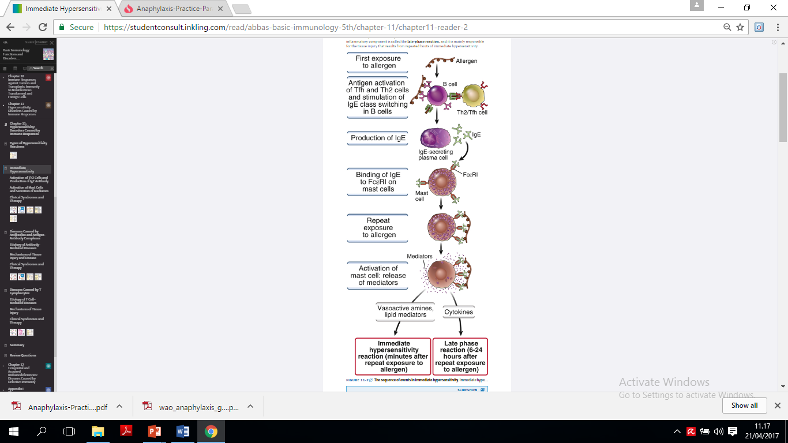
The sequence of events in the development of immediate hypersensitivity reactions
Abbas AK et al. Basic Immunology, fifth edition, 2016

Slide 11
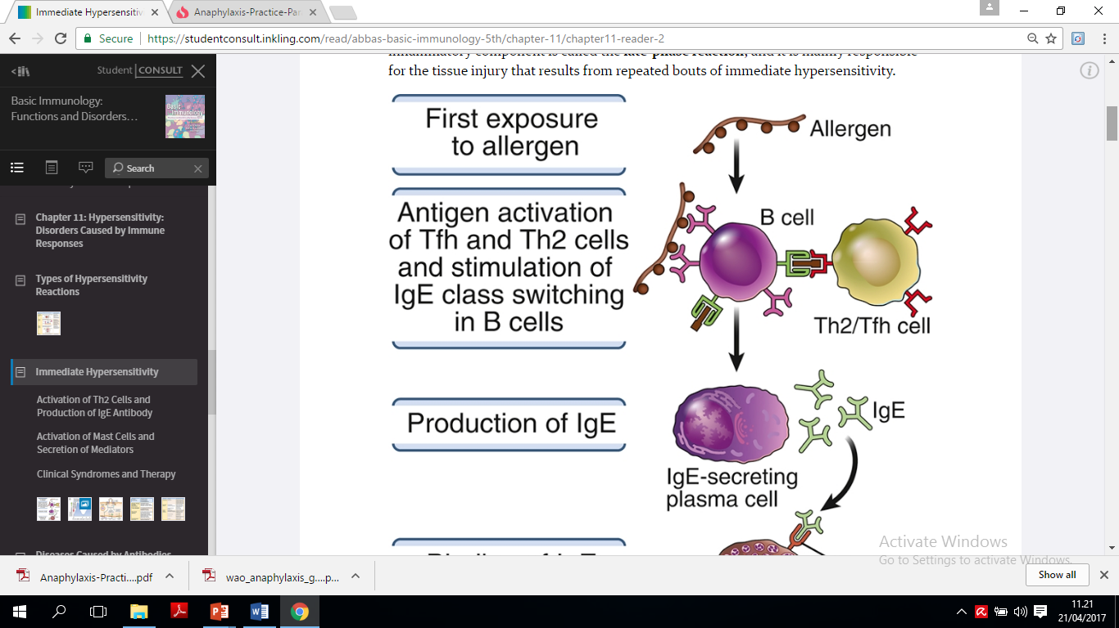
The sequence of events in the development of immediate hypersensitivity reactions 1
Abbas AK et al. Basic Immunology, fifth edition, 2016

Slide 12
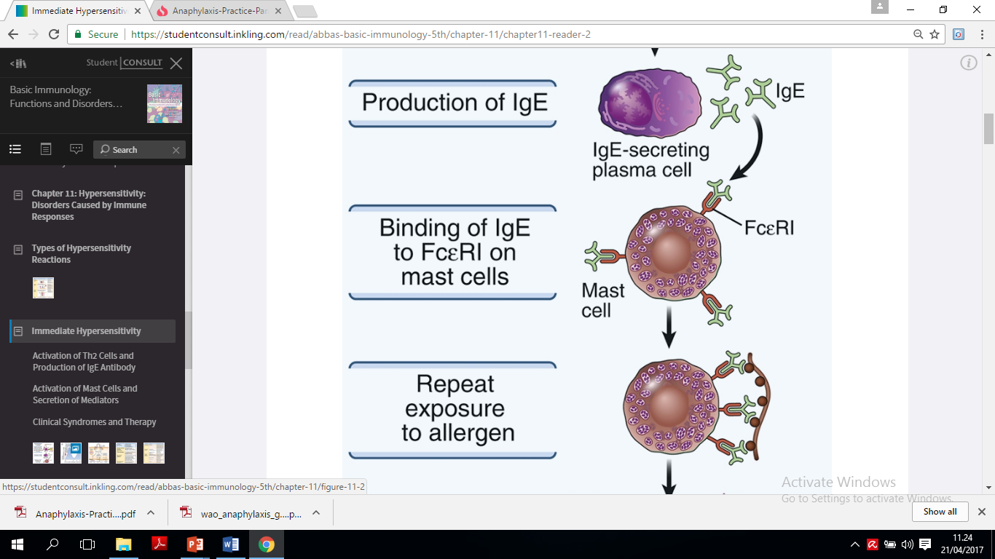
The sequence of events in the development of immediate hypersensitivity reactions 2
Abbas AK et al. Basic Immunology, fifth edition, 2016

Slide 13
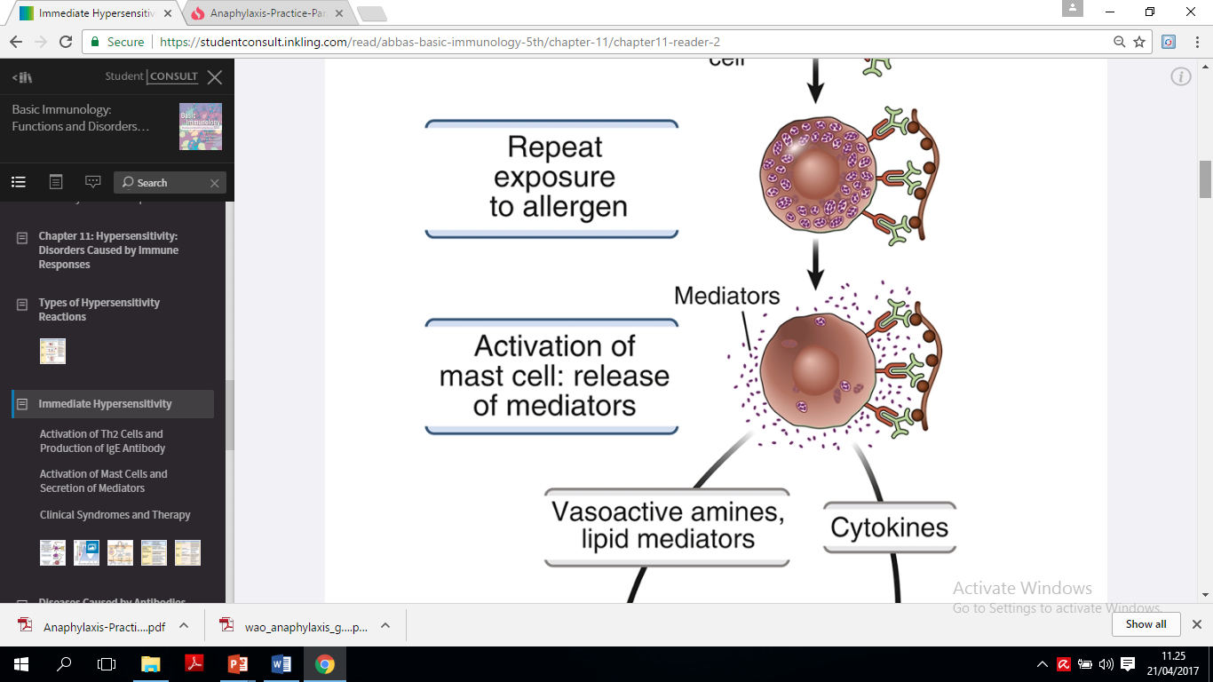
The sequence of events in the development of immediate hypersensitivity reactions 3
Abbas AK et al. Basic Immunology, fifth edition, 2016

Slide 14
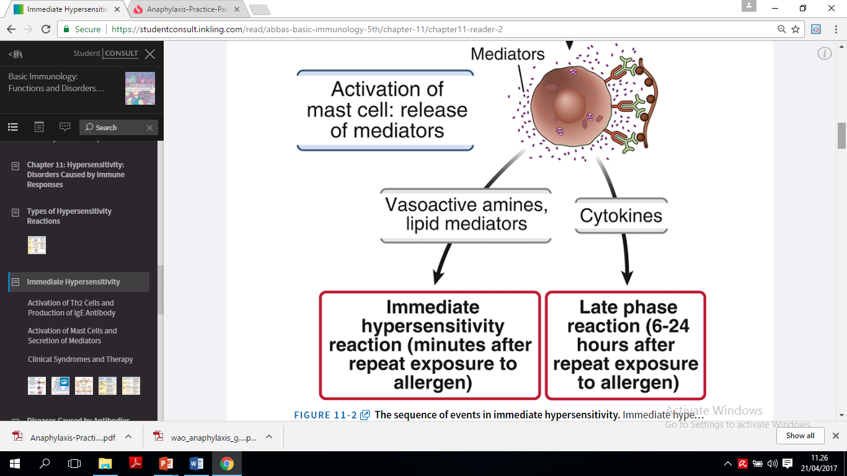
The sequence of events in the development of immediate hypersensitivity reactions 4
Abbas AK et al. Basic Immunology, fifth edition, 2016

Slide 15
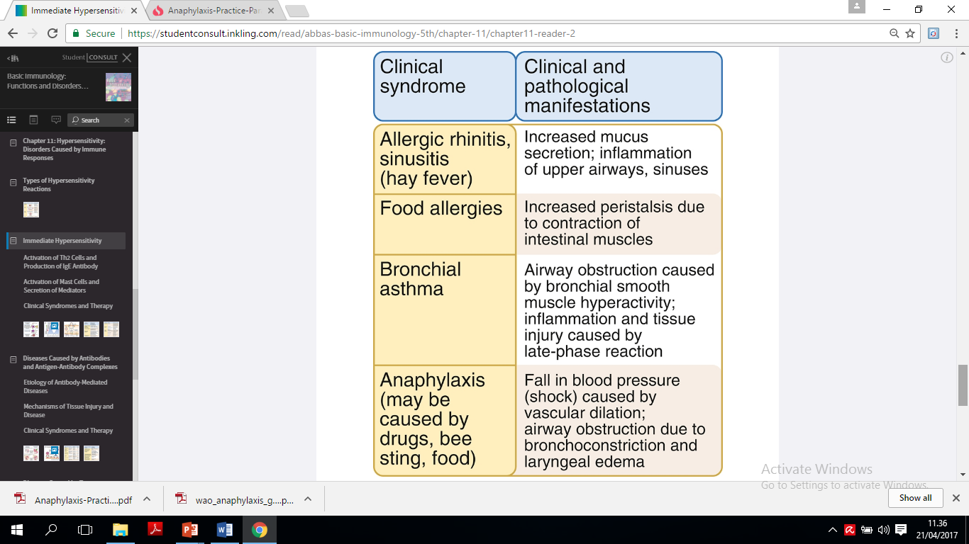
Clinicopathological manifestation in type I hypersensitivity
Abbas AK et al. Basic Immunology, fifth edition, 2016

Slide 16
The immunologic spectrum
IgE-Mediated
Rhinitis alergica
Asthma bronchiale
Urtikaria
Anaphylaxis
Non-IgE-Mediated
Protein-induced enterocolitis
Protein-induced enteropathy
Eosinophilic proctitis
Dermatitis herpetiformis
Celiac disease
Eosinophilic esophagitis
Eosinophilic gastritis
Eosinophilic gastroenteritis
Atopic dermatitis
Clinical manifestation

Slide 17
clinical history
physical examination
Allergy diagnosis testing
In vivo/in vitro

Slide 18
IgE-mediated hypersensitivity diagnostic procedures
In vivo
Skin test (SPT, IDT)
Provocation
test
In vitro
IgE specific
Cellular
Allergy
Testing
Tanno LK et al. J Allergy Clin Immunol Pract 2016;4:650-7

Slide 19
T-Lymphocyte-mediated hypersensitivity diagnostic procedures
In vivo
Skin test (Patch test, IDT)
Provocation
test
In vitro
Lymphocyte transformation blood test
Enzyme-Linked ImmunoSpot (ELISPOT)
Tanno LK et al. J Allergy Clin Immunol Pract 2016;4:650-7

Slide 20
Skin Test
Skin test (Skin prick tests (SPTs) and intradermal Tests) are still the cornerstone of the diagnosis of IgE-mediated (type I) allergy
Easy to perform, cheap and allow a fast reading
Ideal tool for bedside diagnosis
Skin tests usually confirm sensitization to an allergen
Skin tests help confirm the diagnosis of allergy when associated with a compatible history

Slide 21
Skin test
Skin prick test
Atopy pacth test
Intra dermal test

Slide 22
The SPT and IDT are particularly important to demonstrate an IgE-dependent (type I mechanism) sensitization
Patch test and/or the IDT with late reading are indicated for T-lymphocyte sensitization (type IV mechanism)

Slide 23
SPT are the classical diagnostic tool get prompt information about sensitizations against inhalant allergens
For food allergy mostly SPT is used, done with commercially available food allergen extracts but also with fresh food
SPT results should be interpreted with caution in children younger than 2 yrs of age
Contraindications for SPT are as follows: active eczema on the test site or use of antihistamines within 3 days prior to SPT

Slide 24
Intradermal testing may be indicated in specific indications (e.g. drug allergy)
Intradermal testing with food allergens is not recommended

Slide 25
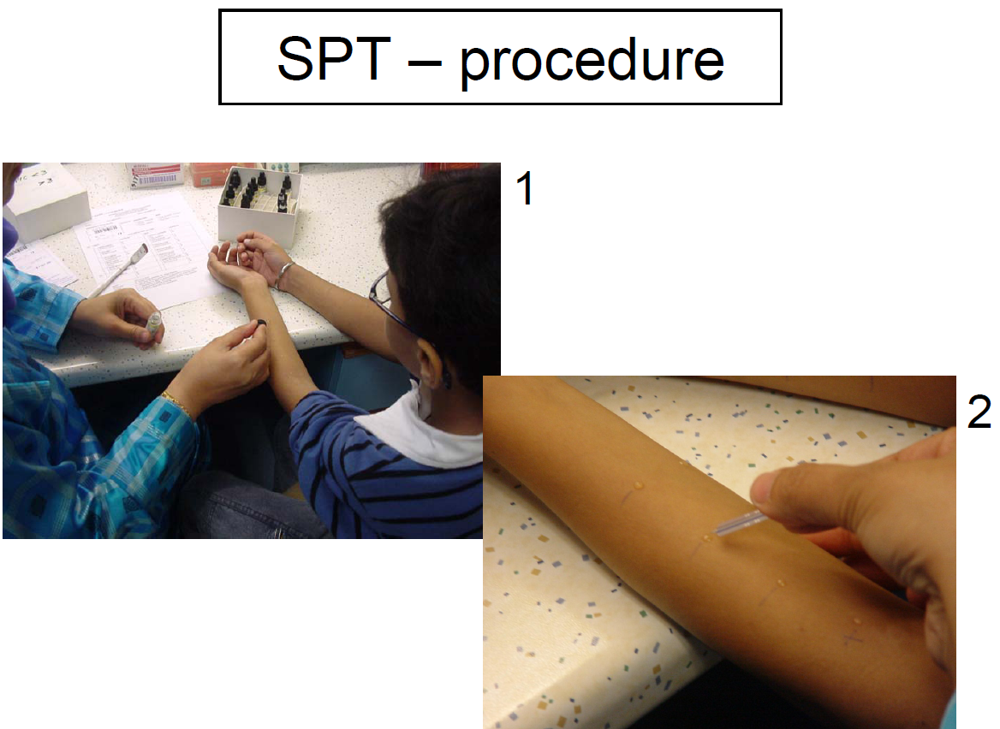

Slide 26
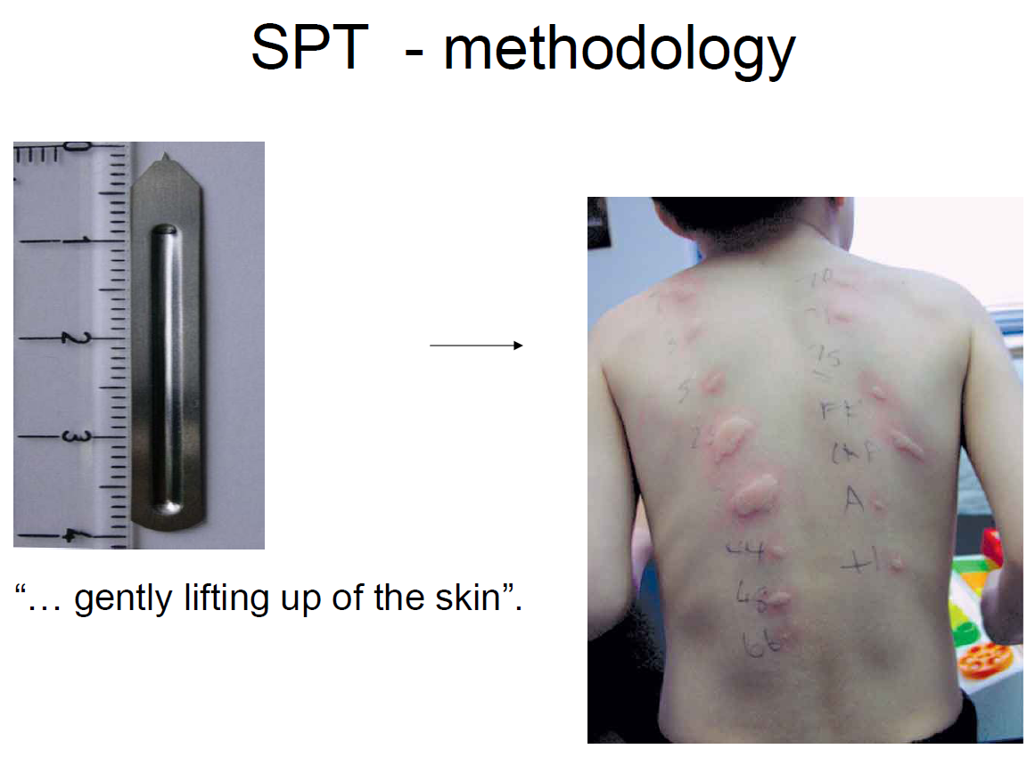

Slide 27
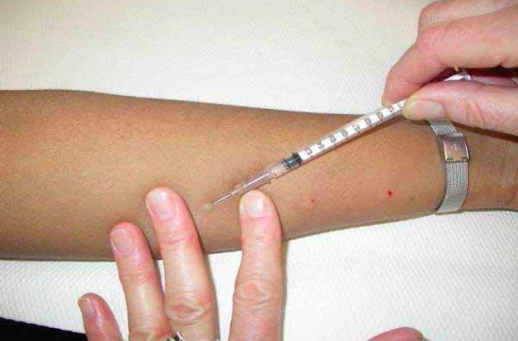
Intra dermal testing

Slide 28
Provocation test
The provocation tests are considered the gold standard of in vivo procedures
Should be performed in a safe setting and must be indicated, supervised, and interpreted by an allergist
Indicated to confirm diagnosis, to provide a safe alternative (eg, drug challenges), to follow up previous diagnosis of allergy

Slide 29
Food provocation test
Food challenge is the diagnostic gold standard for food allergy
Patient safety is key to the design of a food challenge
Interpreting a food provocation test can be challenging
Food challenges are essential procedures in the follow-up of food allergy

Slide 30
Algoritma diagnosis alergi makanan
Anamnesis – untuk identifikasi makanan yang berpotensi dan bentuk dari reaksi
Dicurigai reaksi yang bukan diperantarai IgE
Dicurigai reaksi yang diperantarai IgE
Pemeriksaan Laboratorium dengan/atau endoskopi, biopsi
Uji kulit
(Prick Skin Test)
Positif
Negatif
Coba Makanan
Pemeriksaan IgE spesifik
Telur-, susu-, kacang-, dan ikan
Riwayat Anafilaktik
No
Yes
> Nilai diagnostik
< Nilai diagnostik
Pembatasan makanan
Pembatasan makanan
Memulai diet eliminasi

Slide 31
………Algoritma diagnosis alergi makanan
Memulai diet eliminasi
Gejala tetap
Gejala membaik
Coba makanan dengan pengawasan
Curiga reaksi yang
bukan diperantarai IgE
Observasi 4 Jam
Curiga reaksi yang diperantarai IgE
Positif
Meragukan
Negatif
positif
Negatif
DBPCFC
Pembatasan makanan
Lanjutkan makanan s/d 5 hari
Negatif
Positif
Gejala berulang
Tidak ada gejala
Pembatasan makanan
Makanan diteruskan

Slide 32
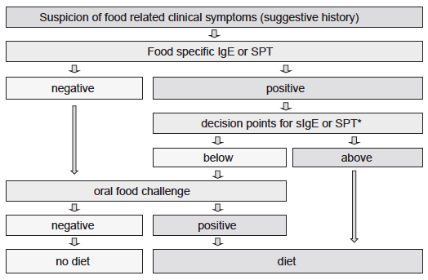
How to proceed from the suspicion of food-related symptoms
to the final decision on recommending a therapeutic specific
elimination diet

Slide 33
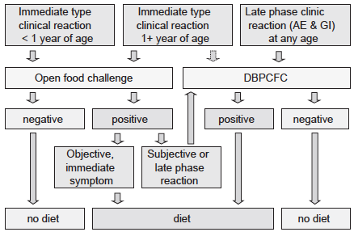
Decision tree for food allergy including either an open food challenge, or DBPCFC

Slide 34
Drug provocation test
A drug provocation test is the controlled administration of a drug for diagnostic purposes
It is the golden standard to confirm or exclude drug hypersensitivity
Specific protocols are available for several drugs
A drug provocation test is often the only reliable way to establish
Diagnosis and should be considered after risk-benefit analysis
The oral provocation test is the preferred route for most DPTs

Slide 35
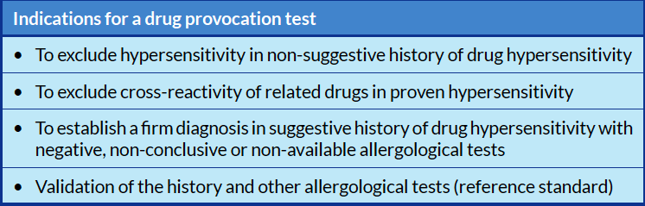
Alberer W. Allergy 2003;58: 854-863.

Slide 36
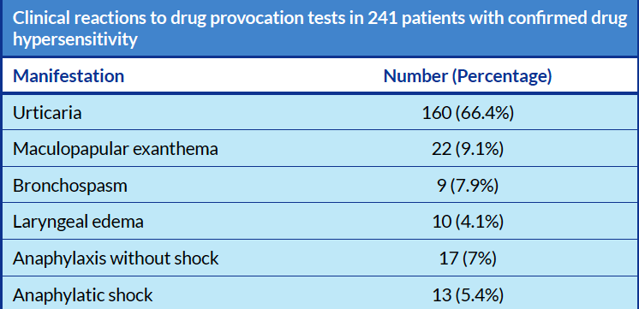
Alberer W. Allergy 2003;58: 854-863.

Slide 37
Allergen-specific IgE
Elevated serum levels of allergen-specific IgE demonstrate the atopic status of a patient
Rapid screening of the sensitization spectrum of a patient without risks for adverse reactions
Can be useful to design a patient-tailored immunotherapeutic intervention
For allergy diagnosis, elevated allergen-specific serum IgE levels need to be interpreted with the clinical history

Slide 38
The prototype for the in vitro detection of serum IgE (the radioallergosorbent test, RAST)
To date the most commonly used system to determine allergen-specific IgE is the ImmunoCAP system (Thermo Fisher Scientific, Uppsala)
Considered as the “gold standard” for the in vitro diagnosis of allergic conditions

Slide 39

From left L. Wide, H. Bennich and S.G.O. Johansson presenting RAST in 1974

Slide 40
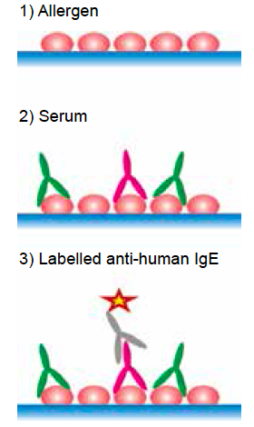
Typical immunoassay for the detection of allergen-specific IgE

Slide 41
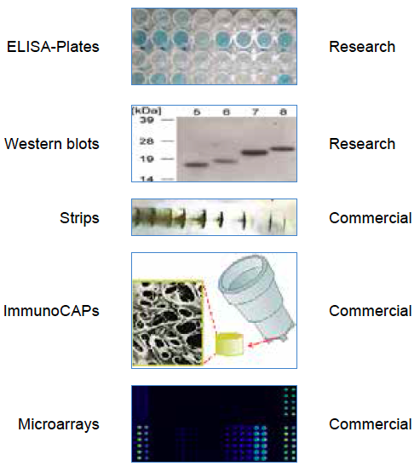
Most commonly used techniques for the detection of allergenspecific IgE

Slide 42
Cellular allergy testing
Cellular allergy tests expand the tools of the allergist to diagnose and monitor allergic disease
The most common cellular test applied is basophil activation test (BAT)
BAT documents type I sensitisation to an allergen

Slide 43
Indication
The patient history and specific IgE or skin tests are discordant
There is no reliable specific IgE or skin test
skin tests may elicit a systemic response

Slide 44
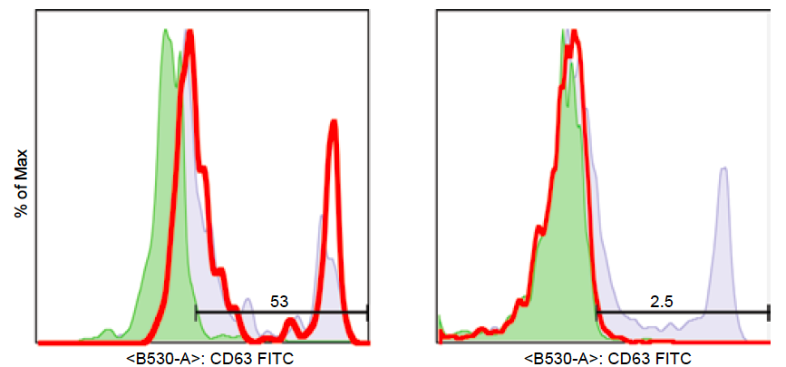
Basophil activation in clinical diagnosis of allergy

Slide 45
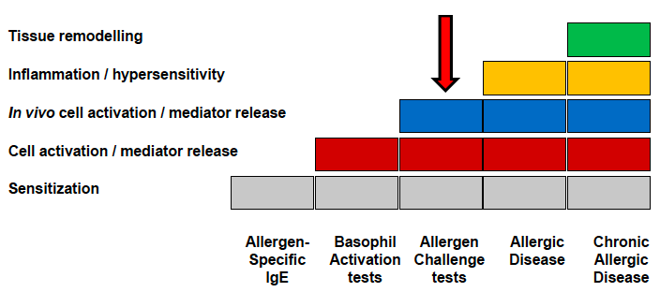
Steps involved in the development of allergic diseases

Slide 46
Unproven and non-validated diagnostic tests
IgG4
Vega test (electromagnetic conductivity)
Applied kinesiology
Hair analysis
Iridology
Facial thermography
Gastric juice analysis

Slide 47

Thank You

